Slide 1



British Airways data science programme
Predicting customer buying behaviour
github.com/luis-cj
linkedin.com/in/luis-cj

Slide 2
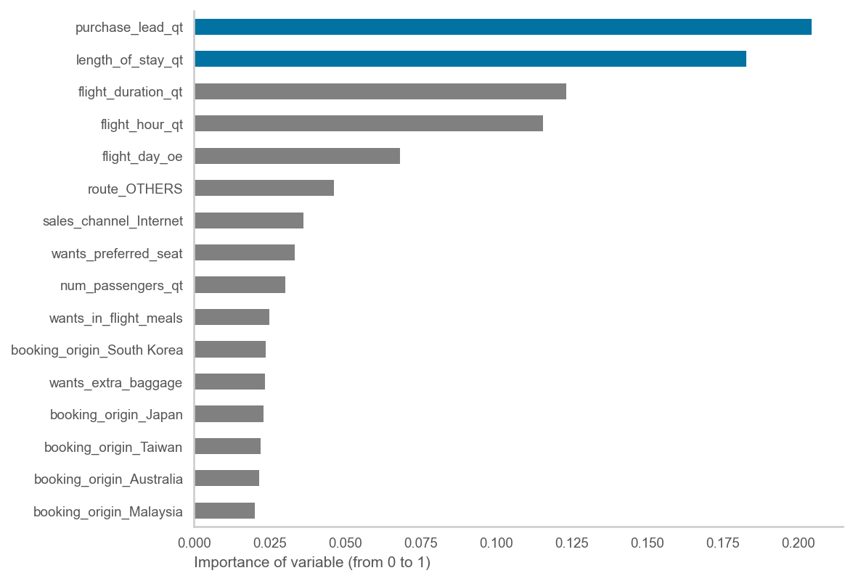
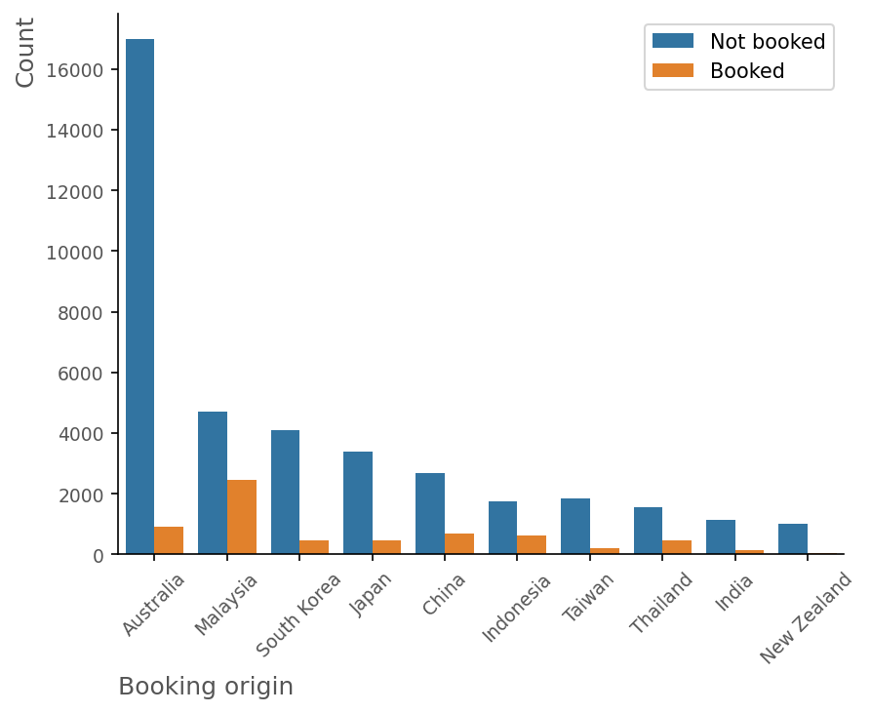
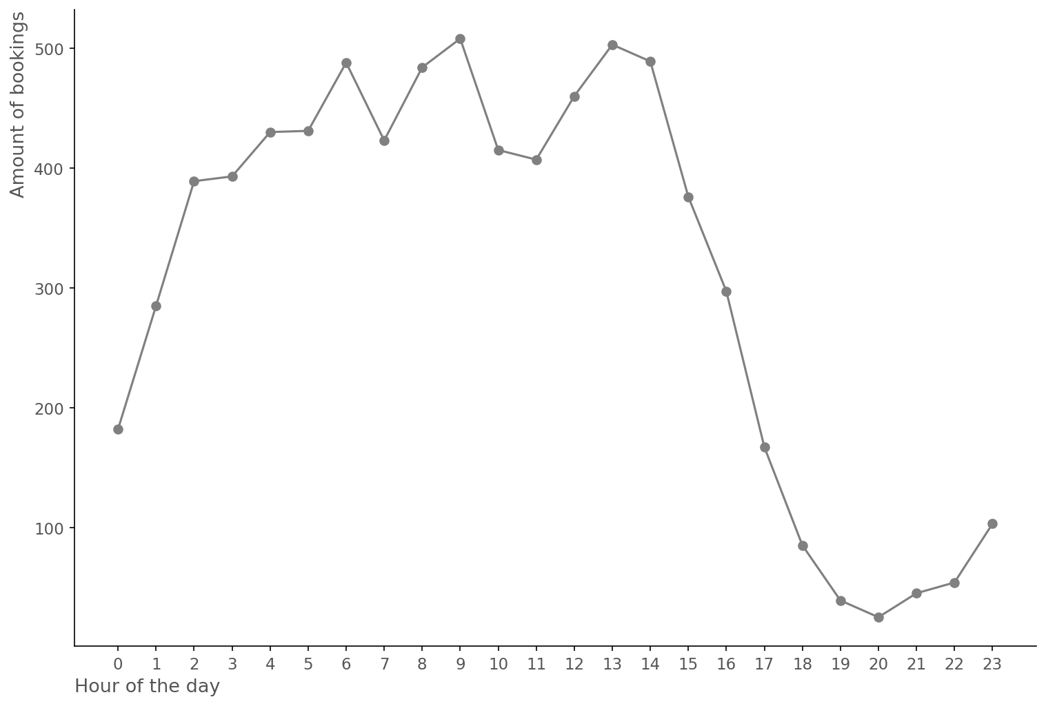
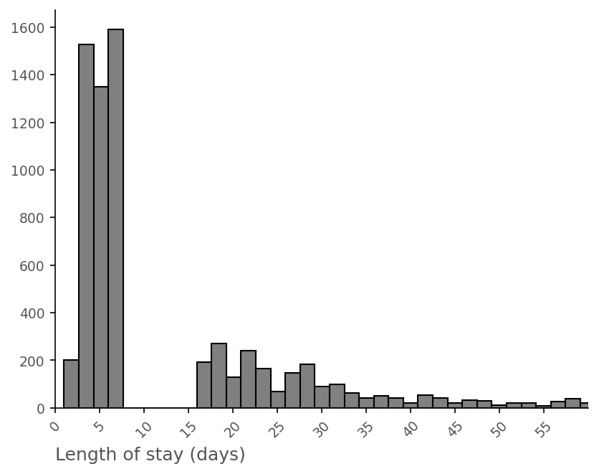
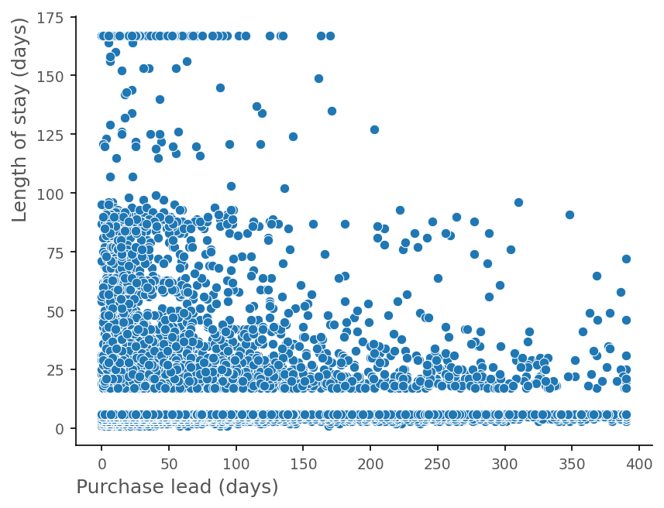
Exhibit 1: The most important variables to consider a customer booking a flight are the purchase lead (how many days in advance they book the flight) and the length of stay in their destination
Exhibit 2: Most clients requiring bookings from Australia do not eventually proceed with the booking. Further actions should be considered to convert more visits into bookings in this case.
The machine learning model presents a mean ROC AUC score of 0.76 after performing cross-validation with 3 different subsets.
Exhibit 3: Most bookings take place for flights between 6am and 3pm. The least
bookings are for late flights between 6pm and 11pm
Exhibit 4: Most bookings require a length of stay in the destination of less than a week, suggesting that customers are looking for business trips or short holidays at the destination.

